Slide 1
Facet study
Final photon absorber material and magnet study

Slide 2
Flux on facet 14886: beam right, central area, rough copper scattering on final photon absorber
Region | Flux on facet
Dipole central | 1.09e+16
Dipole tail | 1.17e+15
Q0 central | 0
Q0 tail | 9.85e+11
Q1 central | 1.7e+11
Q1 tail | 2.84e+13
Dipole central + tail | 1.21e+16
Dipole central + tail upstream 100% stick | 1.14e+16
Dipole central + tail final absorber 100% stick | 1.75e+15

Slide 3
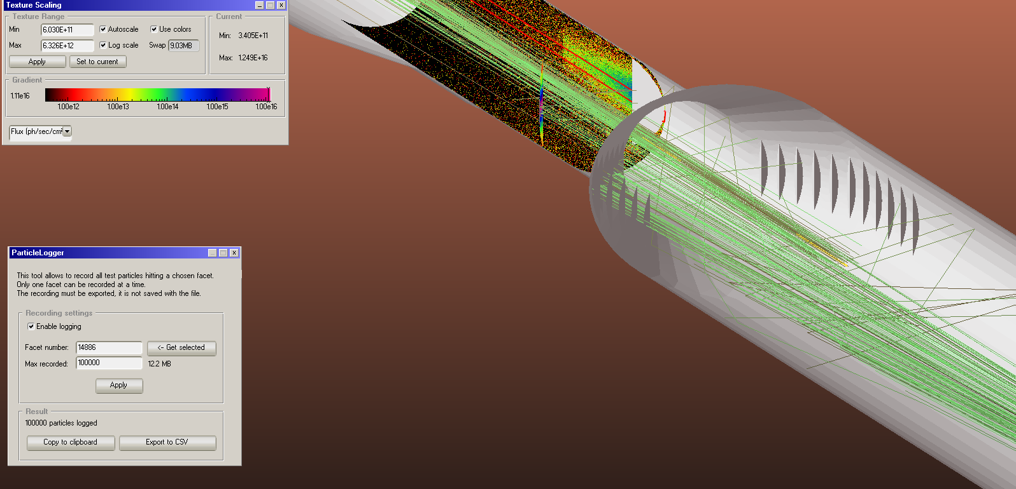
All magnets, copper 0.05 rough

Slide 4
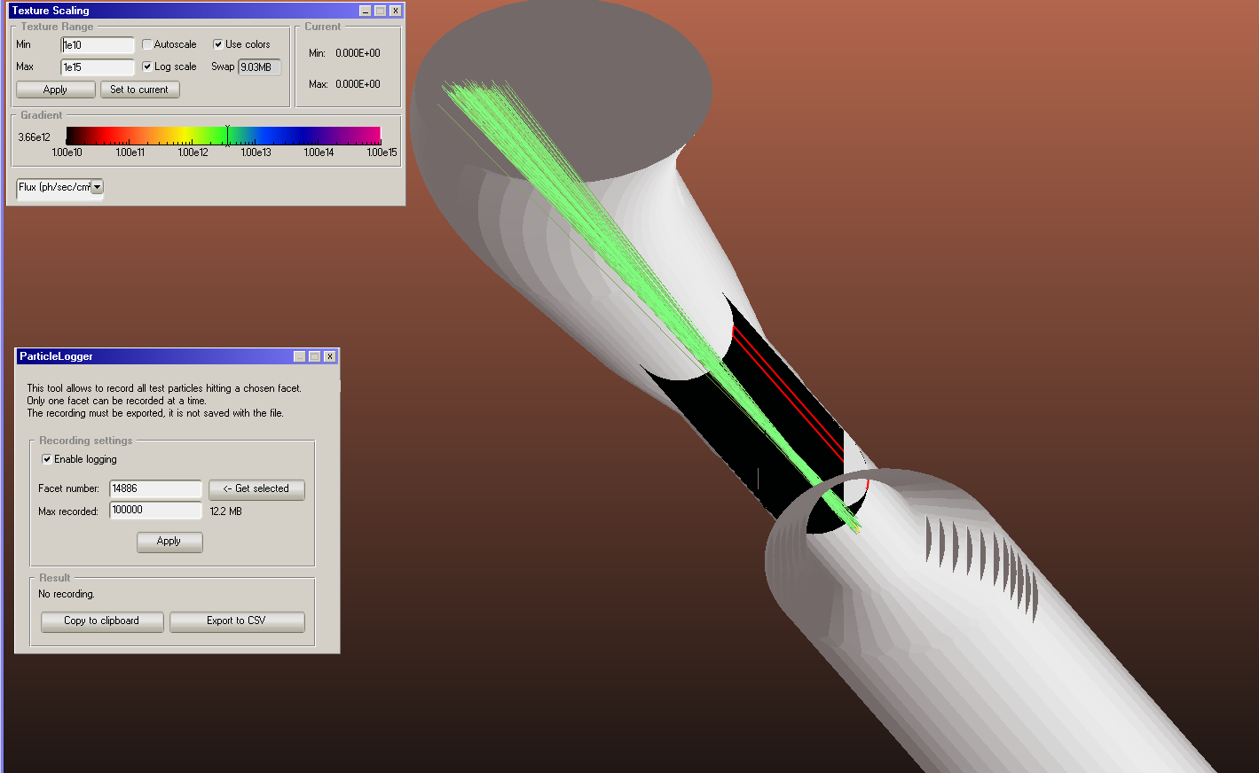
Q0: no flux

Slide 5
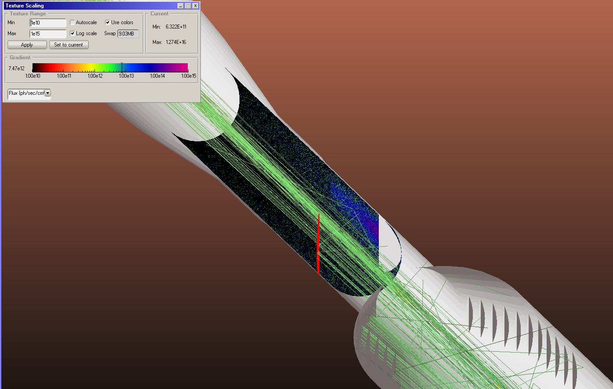
Copper, rough surface scattering, 0.05

Slide 6
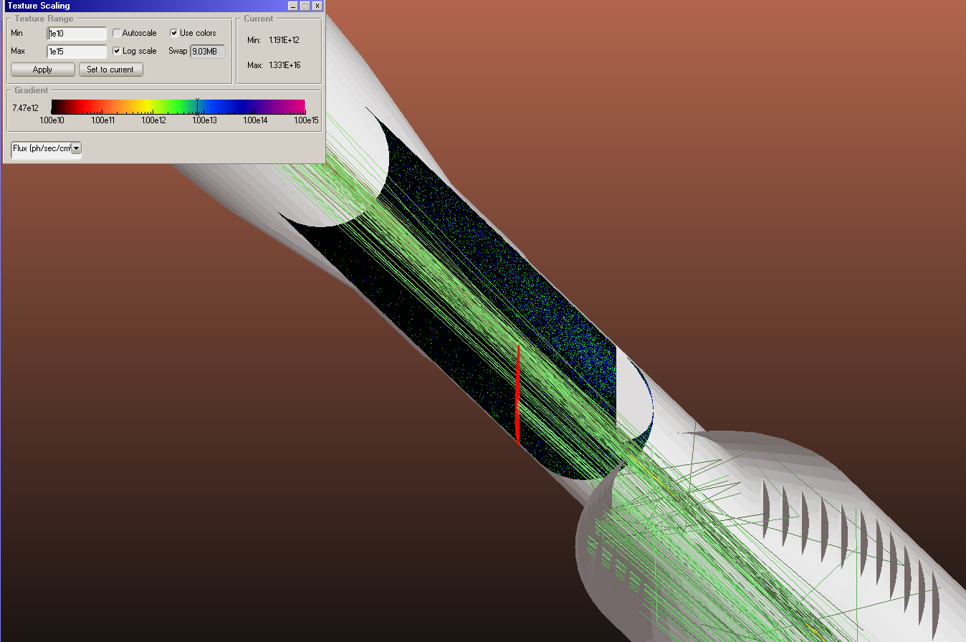
Diffuse sticking 100%

